Slide 1
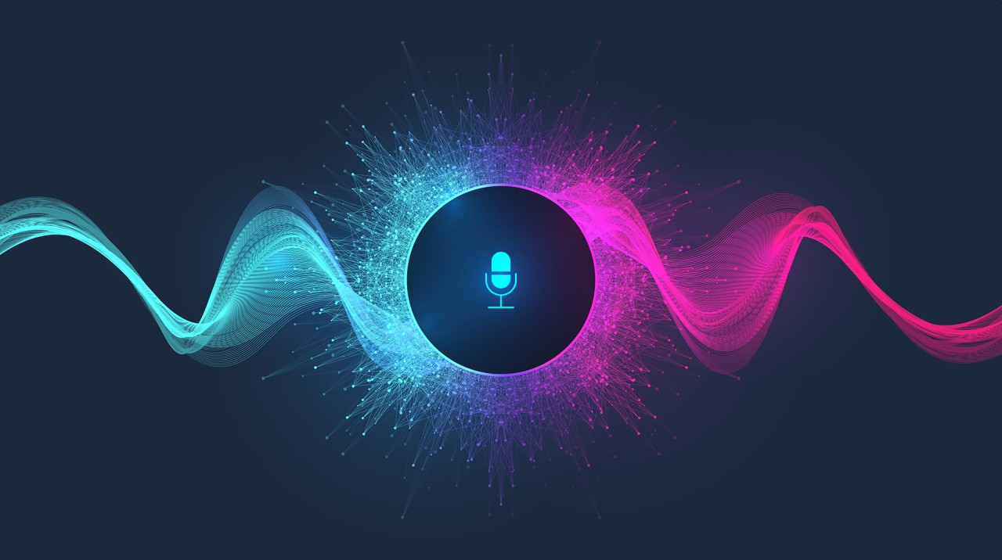
Elysia: Your AI-Powered
Voice-Assisted Therapist

Slide 2

INTRODUCTION
1. Mental Health Crisis
970M+ people affected globally (WHO).
Care limited by cost, stigma, and lack of therapists.
2. AI as a Solution
AI + NLP + Voice tech = accessible, effective self-help tools.
Reduces distress, improves emotional health.
3. Meet Elysia
Voice-enabled, emotionally intelligent AI therapist.
Uses CBT, mindfulness, and real-time sentiment analysis.
Offers a natural, human-like therapy experience.

Slide 3

ABSTRACT
As technology evolves, so does its potential to transform mental health care. Traditional therapy models, though effective, face scalability issues in meeting the growing global demand. Elysia introduces a novel approach—leveraging voice-based AI to create a more emotionally intuitive and responsive mental health assistant. Unlike static chatbots, Elysia dynamically adapts to tone, mood, and speech, engaging users in interactive therapeutic experiences grounded in evidence-based methods like CBT and mindfulness. This project not only aims to improve emotional accessibility through innovation but also evaluates how AI-human interaction can redefine mental well-being in the digital age.

Slide 4
EXISTING SYSTEM
System Name | Description | Technology Used | Advantages | Limitations
AI Therapist (AI-T) for Gait Training | Uses AI to provide expert verbal cues for stroke patients undergoing robot-assisted gait training. Trained on professional therapist cues and real patient data. | Neuro-fuzzy system (combines fuzzy logic & neural networks) | - Provides consistent and expert-level verbal cues for therapy. - Enhances patient motivation and motor learning. - Adaptive to individual patient needs. | Limited to gait training; does not address broader mental health therapy.
SERMO – Mental Health Chatbot | AI-powered chatbot designed to help users regulate emotions and provide emotional support. Addresses the shortage of mental health professionals. | NLP (Natural Language Processing) & Emotion Recognition Algorithms | - Provides immediate emotional support. - Accessible to users anytime. - Helps bridge the gap in mental health resources. | May not fully replace human therapists. Effectiveness depends on user engagement.
Dialogue System for Early Mental Illness Detection | AI-powered dialogue system that helps detect mental health issues early through conversational AI and digital twin technology. | Conversational AI & Digital Twin Technology | - Enables early detection of mental illnesses. - Provides personalized mental health assessments. - Can assist psychiatrists in decision-making. | Accuracy depends on data quality. Ethical concerns regarding patient data privacy.

Slide 5
EXISTING SYSTEM
System Name | Description | Technology Used | Advantages | Limitations
AI-Enabled Voice Assistants (VA) | AI-powered voice assistants like Alexa and Siri assist users in daily tasks, information retrieval, and interactive AI applications. | Natural Language Processing (NLP), Speech Recognition & AI-based Recommendation Systems | - Provides hands-free interaction with AI. - Enhances user engagement and convenience. - Can integrate with smart home and personal devices | Privacy concerns regarding user data. Limited contextual understanding in complex conversations.
Chatbots as Conversational Healthcare Services | Examines how chatbots are used in healthcare for prevention, diagnosis, and treatment. Highlights human-AI interaction and transparency issues. | AI-driven Chatbots, NLP, Healthcare Data Processing | - Provides automated diagnosis and healthcare recommendations. - Enhances accessibility to healthcare services. - Supports mental and physical health management. | Ethical and transparency concerns in AI decision-making. May struggle with complex medical conditions requiring human expertise.

Slide 6
PROPOSED SYSTEM
1. Modular Architecture with Dual Communication Modes
Elysia operates on a modular system, where each module handles a specific function—speech recognition, NLP, response generation, etc. Users can choose between voice chat or text chat, personalizing their interaction style.
2. Emotionally Intelligent Interaction
Using Speech-to-Text, NLP, Sentiment & Emotion Analysis, and CBT-based responses, the system understands user intent and mood in real-time, generating empathetic, context-aware replies.
3. Personalized, Privacy-Focused Experience
User data, emotional patterns, and chat history are stored securely. Features like session summaries, mood tracking, and custom dashboards help users reflect and receive tailored mental wellness support.

Slide 7
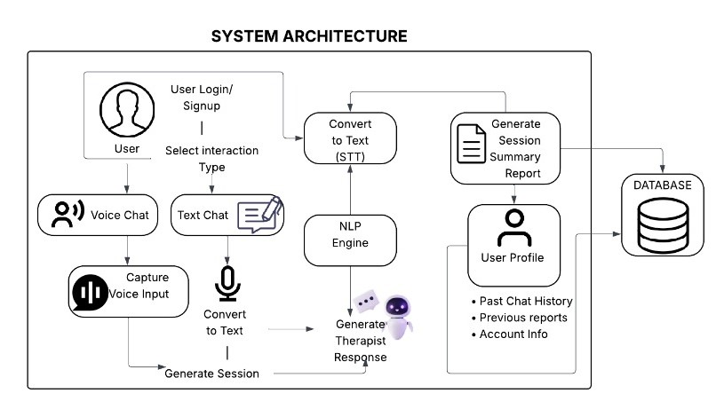
ARCHITECTURE DIAGRAM

Slide 8
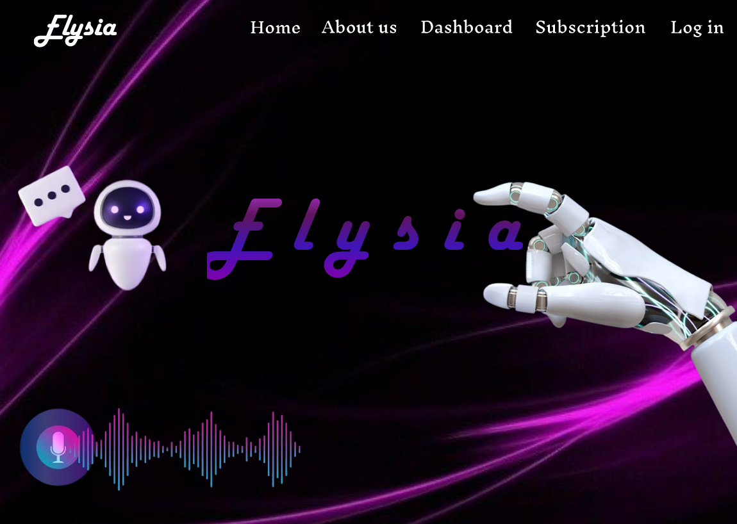
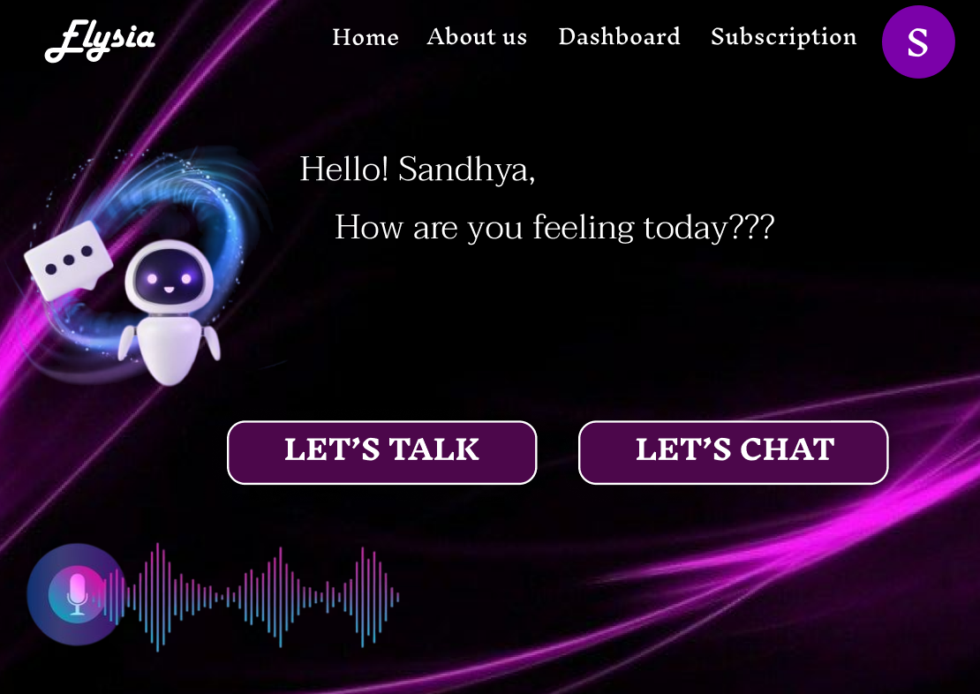
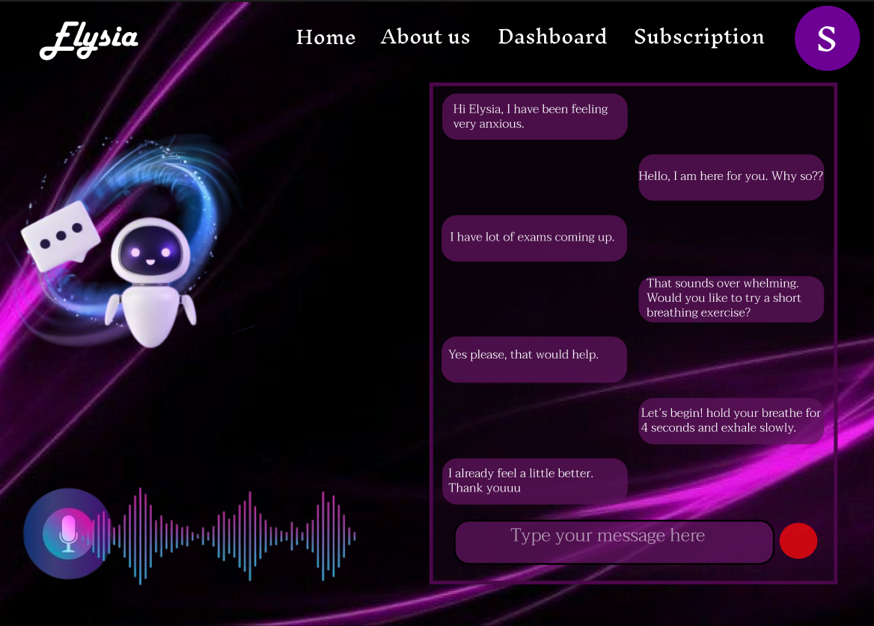
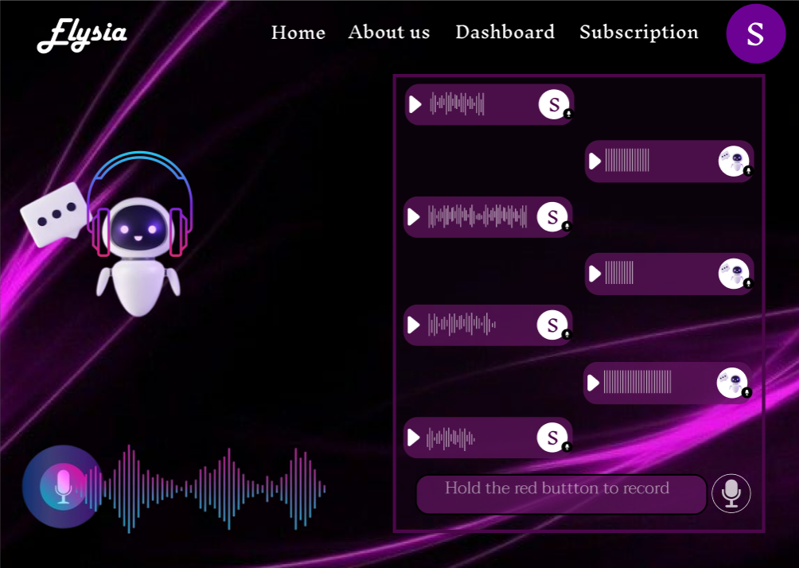
OUTPUT SCREENSHOTS

Slide 9
RESULTS AND DISCUSSION
1. High Accuracy & Emotional Adaptability
Elysia effectively captured voice/text inputs and showed strong speech recognition accuracy even in noisy environments. Its NLP engine reliably detected emotional states like stress, anxiety, or calmness, ensuring relevant, empathetic responses.
2. Positive User Experience & Accessibility
Users found the system easy, intuitive, and emotionally safe to interact with. The friendly tone and non-judgmental responses encouraged open expression, even among those new to mental health tools.
3. Meaningful Feedback & Emotional Tracking
Session summaries offered personalized insights and wellness recommendations. Visualizations like mood trends and chat history helped users track their emotional journey and reflect on progress over time.

Slide 10
FUTURE SCOPE
1. Integration with Licensed Therapists: Enable escalation paths to connect users with certified mental health professionals for advanced support when needed, creating a hybrid human-AI care model.
2. Multi-Language & Cross-Cultural Support: Expand Elysia’s reach by supporting multiple languages and cultural adaptations to serve diverse populations around the globe more effectively.
3. Real-Time Emotion Detection via Voice & Facial Cues: Incorporate voice tone analysis and facial expression recognition (via webcam, with consent) to enhance emotional awareness and response precision.
4. Mobile App Deployment: Develop a dedicated mobile application to improve accessibility, usability, and offline capabilities for users on the go.
5. AI Model Improvements & Personalization: Enhance response quality using continual learning, personalized therapy tracks, and adaptive dialogue generation based on user history and behavior.

Slide 11
CONCLUSION
Elysia represents a major step forward in accessible, AI-powered mental health support.
It combines NLP, speech recognition, and emotion-aware responses to create a safe, empathetic space for users.
With dual-mode input (voice/text), it offers inclusive, user-friendly interaction and real-time therapeutic experiences.
Though not a clinical tool, it supports early self-awareness, emotional tracking, and mental well-being reflection.

Slide 12
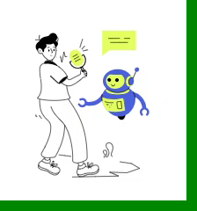
THANK YOU

